Slide 1
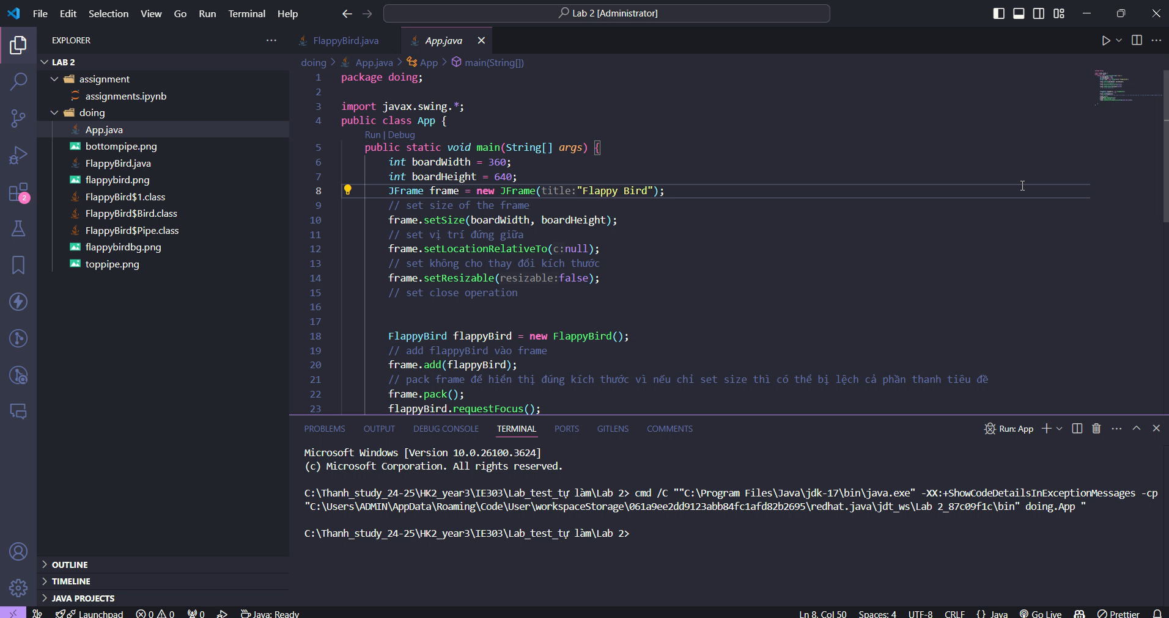
Code and play Flappy Bird

